Slide 1
DNS and Attacks

Slide 2
Outline
DNS Hierarchy,Zones,and Servers
DNS Query Process
DNS Attacks : Overview
Local DNS Cache Poisoning Attack
Remote DNS Cache Poisoning Attack
Reply Forgery Attacks from Malicious DNS Servers
DNS Rebinding Attack
Protection Against DNS Cache Poisoning Attacks
Denial of Service Attacks on DNS Servers

Slide 3
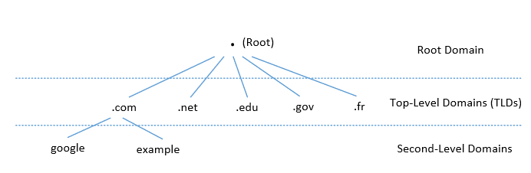
DNS Domain Hierarchy
Domain namespace is organized in a hierarchical tree-like structure.
Each node is called a domain, or subdomain.
The root of the domain is called ROOT, denoted as ‘ . ‘.
Below ROOT, we have Top-Level Domain (TLD). Ex: In www.example.com, the TLD is .com.
The next level of domain hierarchy is second-level domain which are usually assigned to specific entities such as companies, schools etc

Slide 4
Top Level Domain (TLD)
Infrastructure TLD: .arpa
Generic TLD (gTLD): .com, .net,
Sponsored TLD (sTLD): These domains are proposed and sponsored by private agencies or organizations that establish and enforce rules restricting the eligibility to use the TLD: .edu, .gov, .mil, .travel, .jobs
Country Code TLD (ccTLD): .au (Australia), .cn (China), .fr (France), .in (India)
Reserved TLD: .example, .test, .localhost, .invalid

Slide 5
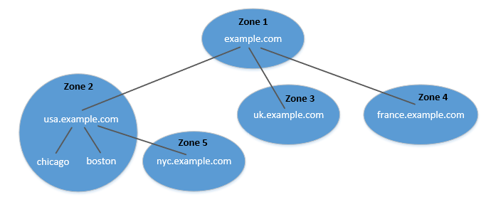
DNS Zone
DNS is organized according to zones.
A zone groups contiguous domains and subdomains on the domain tree and assign management authority to an entity.
The tree structure depicts subdomains within example.com domain.
In this case, there are multiple DNS zones one for each country. The zone keeps records of who the authority is for each of its subdomains.
The zone for example.com contains only the DNS records for the hostnames that do not belong to any subdomain like mail.example.com

Slide 6
Zone vs Domain
A DNS zone only contains a portion of the DNS data for a domain.
If a domain is not divided into subdomains, the zone and domain are essentially the same, because the zone contains all the DNS data for the domain.
When a domain is divided into subdomains, their DNS data can still be put in the same zone, so domain and zone are still the same.
But subdomains can have their own zones.
usa.example.com is a domain with subdomains as boston, nyc and chicago. Two zones are created for usa.example.com. First contains usa domain, chicago and boston subdomain and second contains nyc subdomain.

Slide 7
Authoritative Name Servers
Each DNS zone has at least one authoritative nameserver that publishes information about the zone.
It provides the original and definitive answers to DNS queries.
An authoritative name server can be a master server (primary) or slave server (secondary).
A master server stores the master copies of all zone records whereas a slave server uses an automatic updating mechanism to maintain an identical copy of the master records.

Slide 8
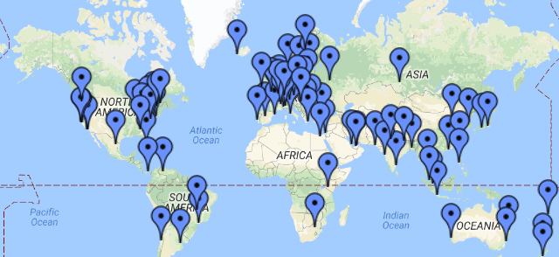
DNS ROOT Servers
The root zone is called ROOT.
There are 13 authoritative nameservers (DNS root servers) for this zone.
They provide the nameserver information about all TLDs
https://www.internic.net/domain/root.zone
They are the starting point of DNS queries.
Notes:
DNS root servers use IP Anycast to improve its scalability, which is essential against DDoS attacks. IP Anycast allows many computers to share the same IP address.

Slide 9
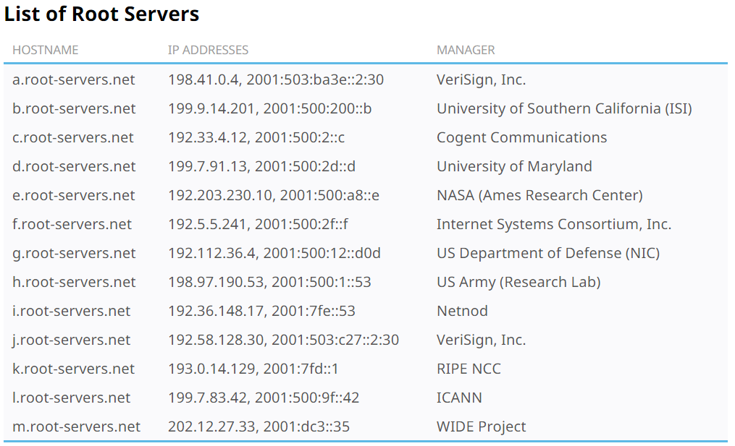
13 DNS Root Servers
They are the most critical infrastructure on the Internet.

Slide 10
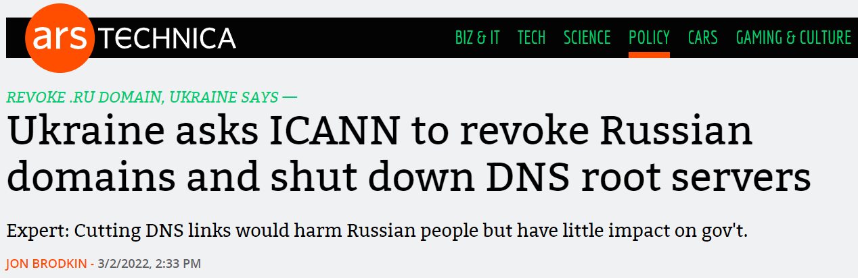
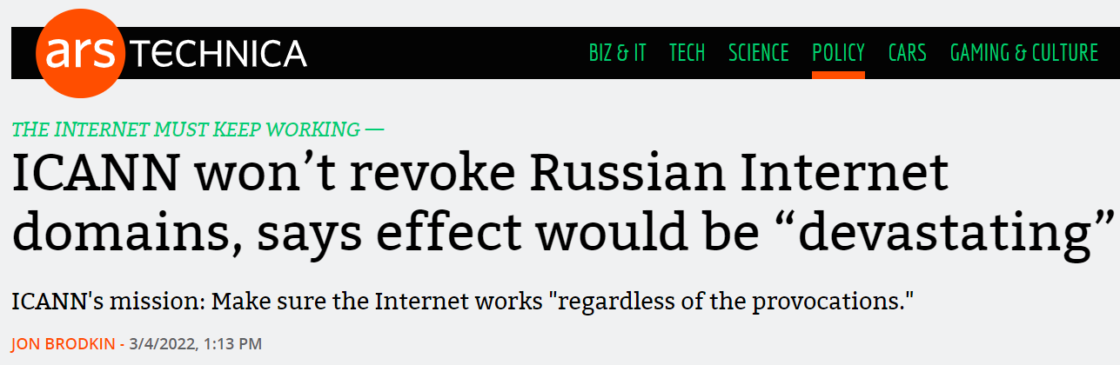
DNS Root Server and Politics

Slide 11
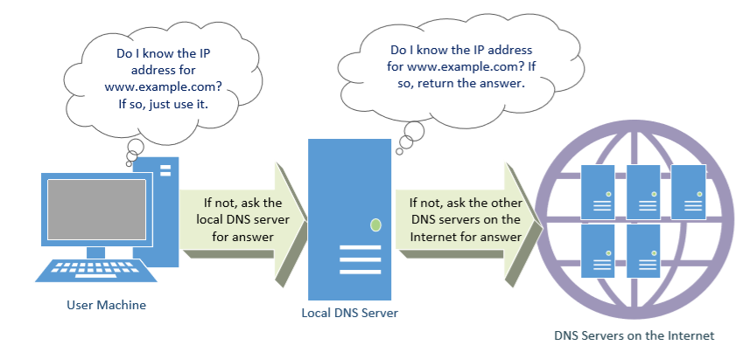
DNS Query Process

Slide 12
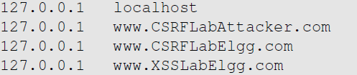
Local DNS Files
/etc/hosts: stores IP addresses for some hostnames. Before machine contacts the local DNS servers, it first looks into this file for the IP address.
On Windows machine, it is stored at C:\WINDOWS\System32\drivers\etc\hosts
/etc/resolv.conf: provide information to the machine’s DNS resolver about the IP address of the local DNS server. The IP address of the local DNS server provided by DHCP is also stored here.

Slide 13
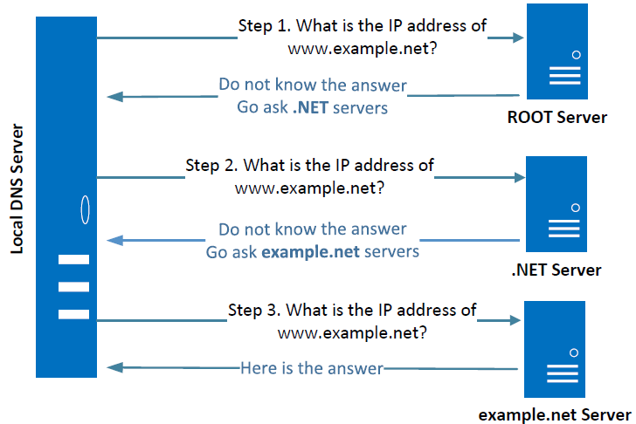
Local DNS Server and Iterative Query Process
The iterative process starts from the ROOT Server. If it doesn’t know the IP address, it sends back the IP address of the nameservers of the next level server (.NET server) and then the last level server (example.net) which provides the answer.
Notes:
The Local DNS servers need not be local. They may or may not be set up in the local network. Google Public DNS is a DNS service offered by Google, serving any host on the Internet.

Slide 14
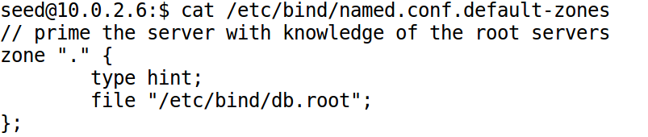
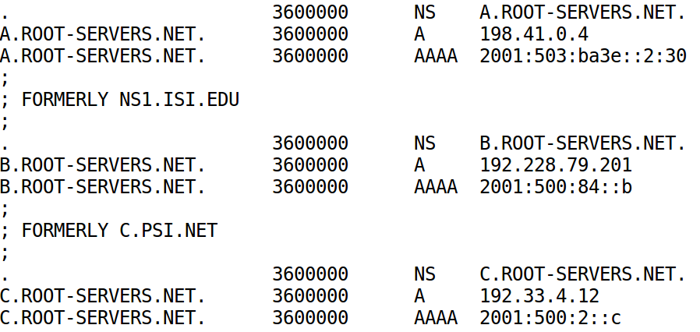
How Local DNS Server Get Root Server's IP

Slide 15
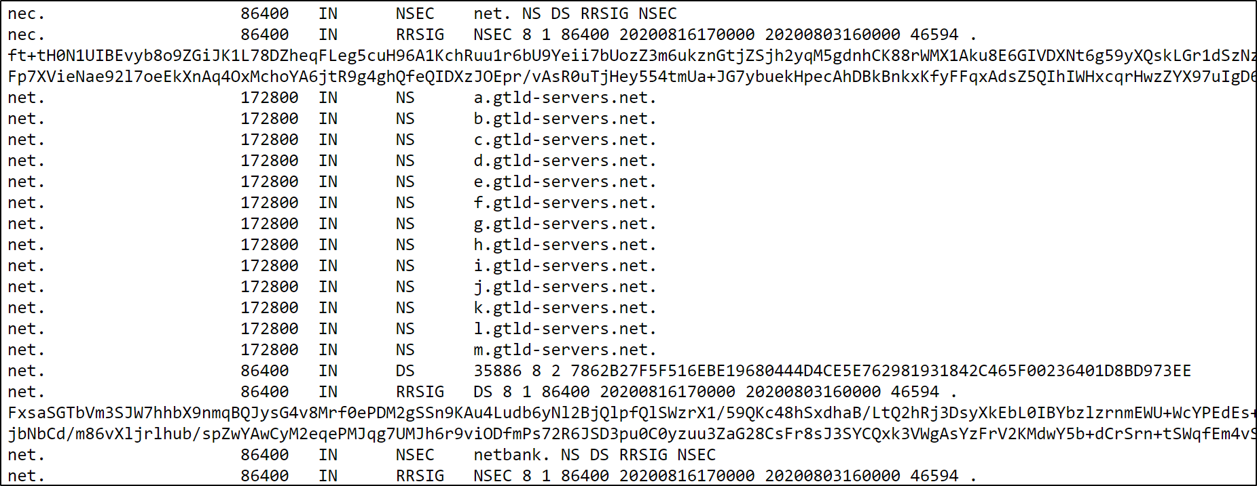
Root Zone File
https://www.internic.net/domain/root.zone

Slide 16
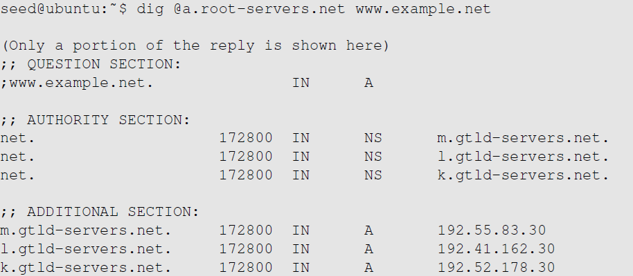
Emulating Local DNS Server (Step 1: Ask ROOT)
Directly send the query to this server.
No answer (the root does not know the answer)
Go ask them!

Slide 17
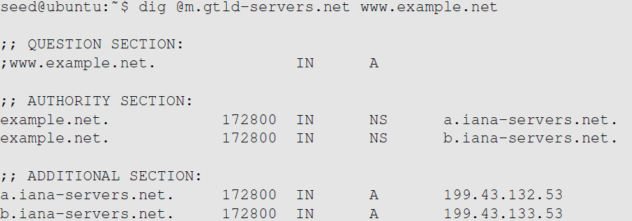
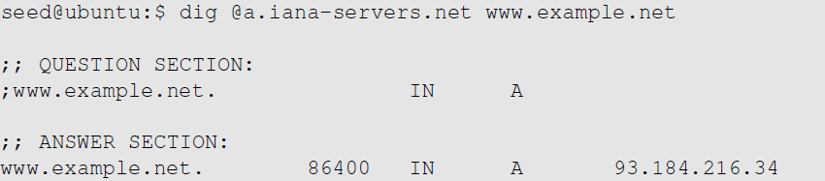

Steps 2-3: Ask .net & example.net servers
Ask a .net nameservers.
Go ask them!
Ask an example.net nameservers.
Finally got the answer

Slide 18
DNS Response
There are 4 types of sections in a DNS response :
Question section : Describes a question to a nameserver
Answer section : Records that answer the question
Authority section : Records that point toward authoritative nameservers
Additional section : Records that are related to the query.
In the above example, we see that as root server doesn’t know the answer there is no answer section, but tells us about the authoritative nameservers (NS Record) along with their IP addresses in the Additional section (A record).

Slide 19
DNS cache
When the local DNS server gets information from other DNS servers, it caches the information.
Each piece of information in the cache has a time-to-live value, so it will be eventually time out and removed from the cache.

Slide 20
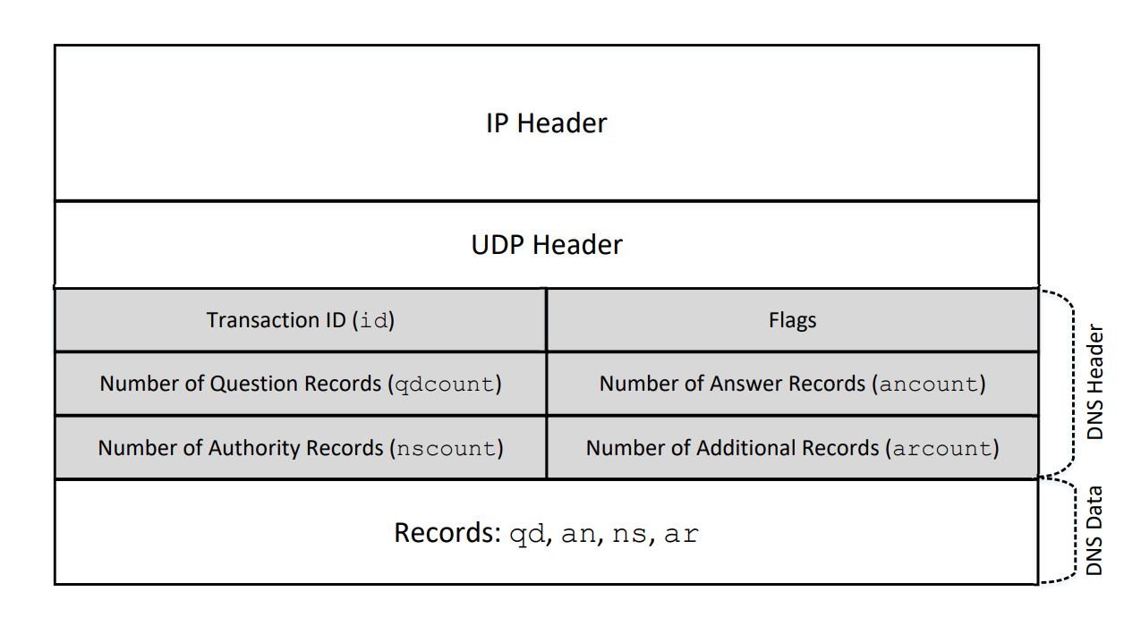
DNS Header

Slide 21
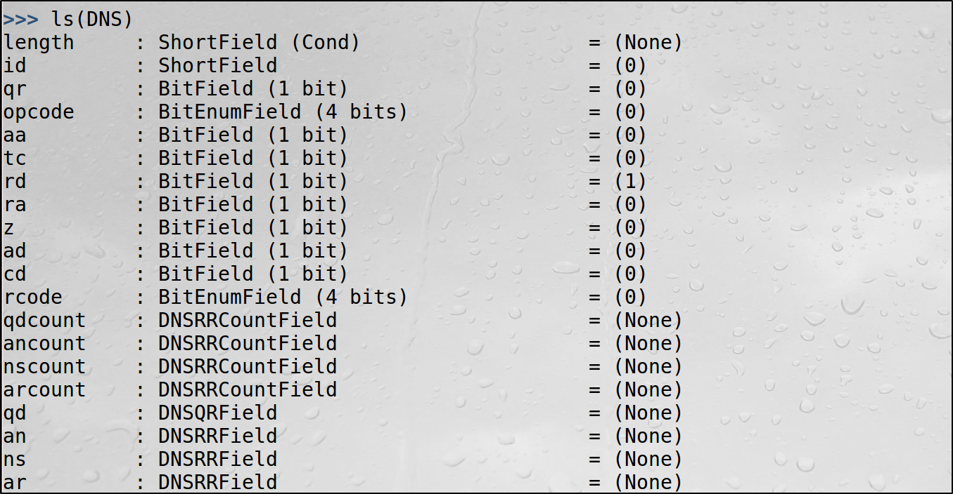
Creating DNS Packets using Scapy

Slide 22
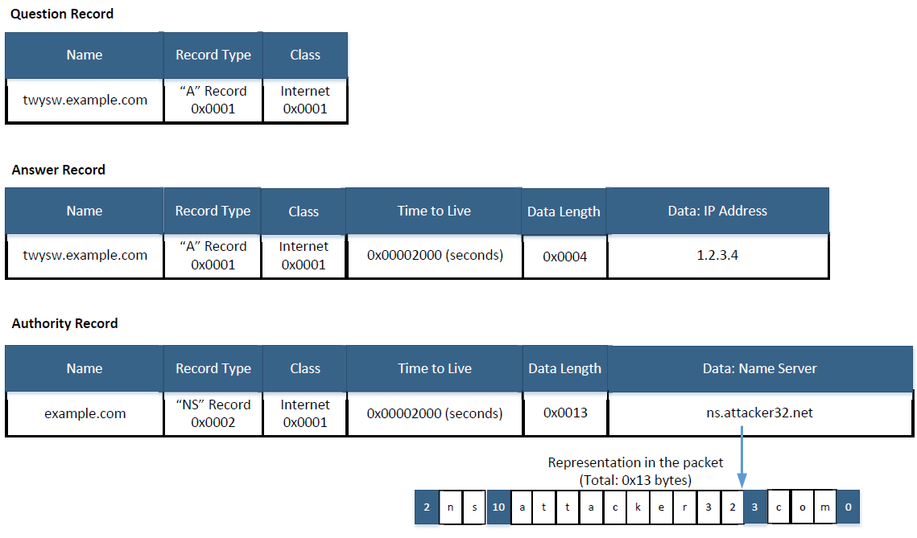
DNS Record Formats

Slide 23
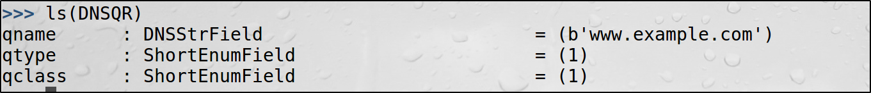
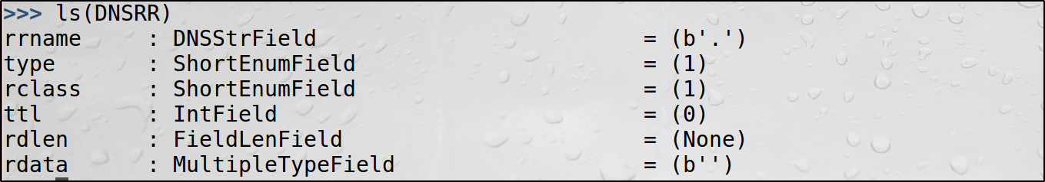
Creating DNS Records using Scapy
DNSQR Class
DNSRR Class

Slide 24
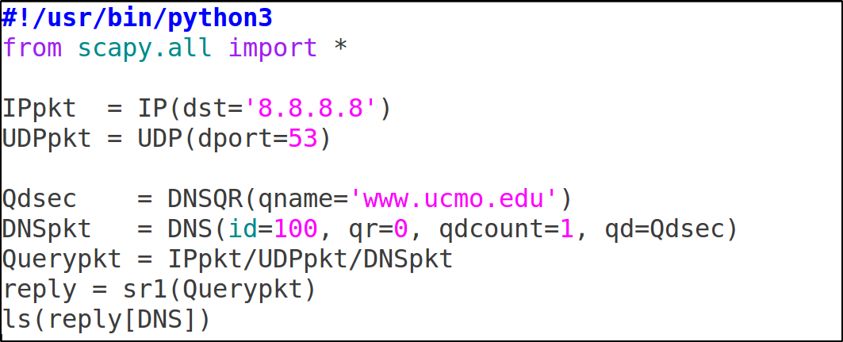
Sending DNS Query

Slide 25
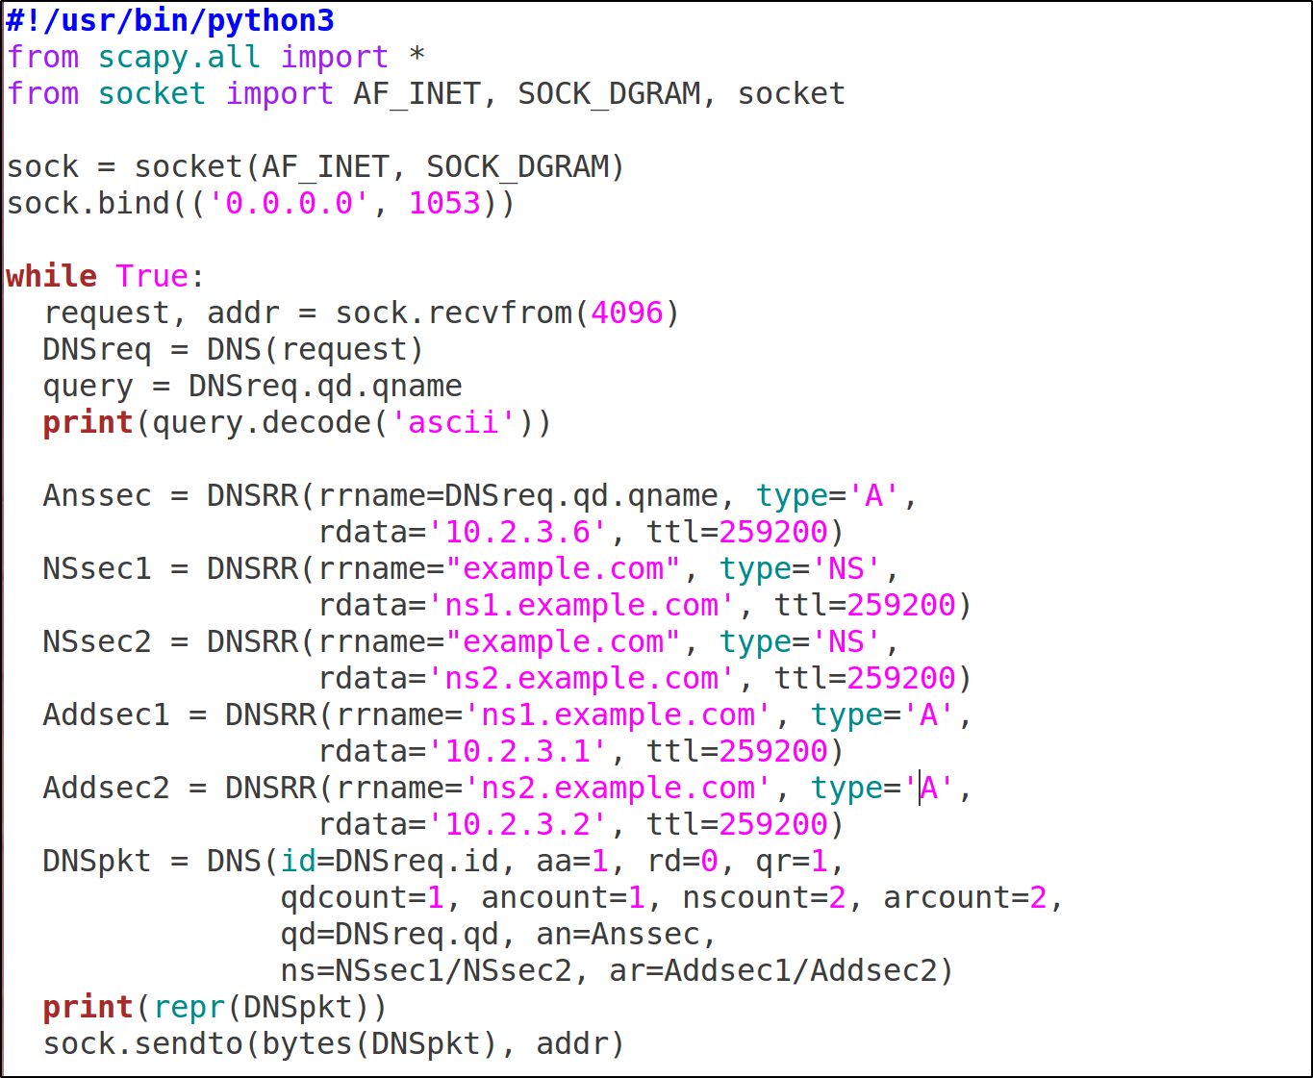
A Sample DNS Server

Slide 26
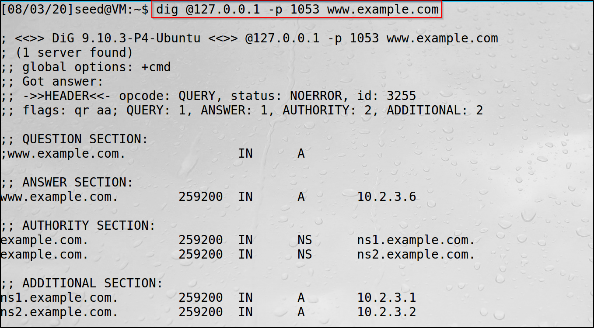
Testing the Sample DNS Server

Slide 27
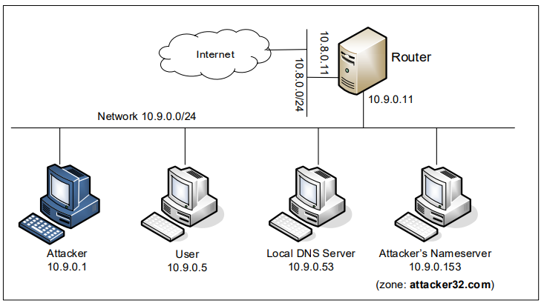
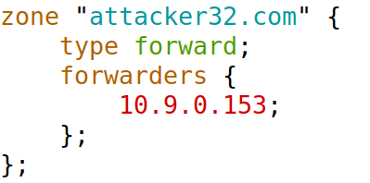
Lab Setup for DNS Attack Labs
On Local DNS Server
/etc/bind/named.conf

Slide 28
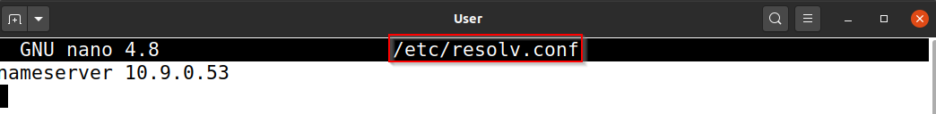
User Machine Setup
The user container 10.9.0.5 is already configured to use 10.9.0.53 as its local DNS server
This is achieved by changing the resolver configuration file (/etc/resolv.conf) of the user machine, so the local DNS server 10.9.0.53 is added as the first nameserver entry in the file, i.e., this server will be used as the primary DNS server

Slide 29
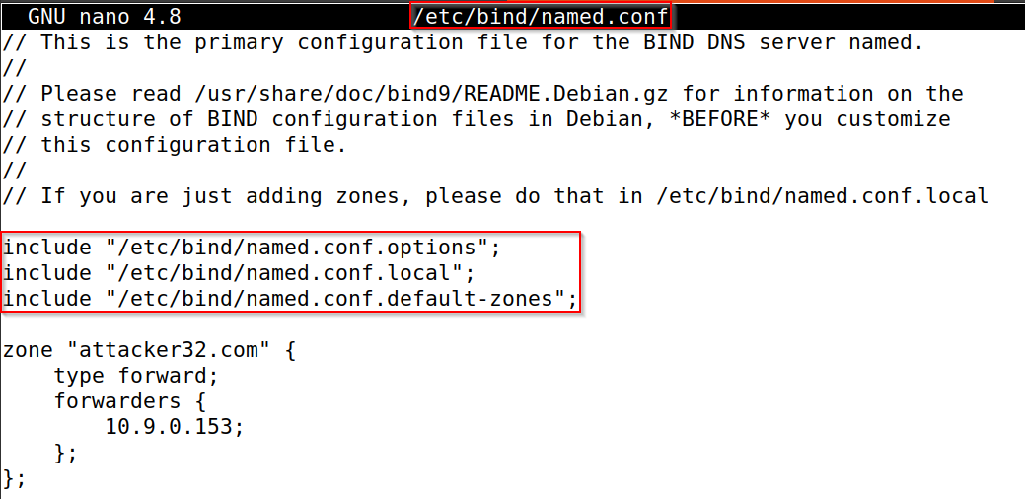
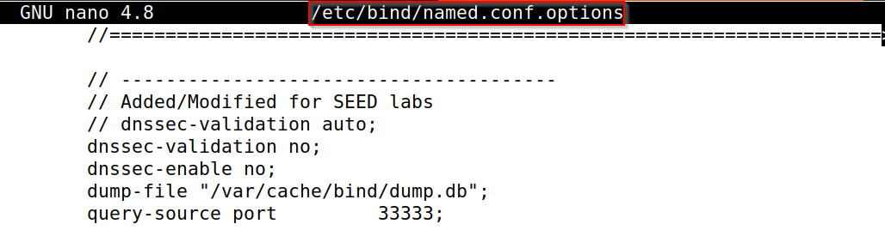
Local DNS Server Setup
BIND 9 gets its configuration from a file called /etc/bind/named.conf

Slide 30
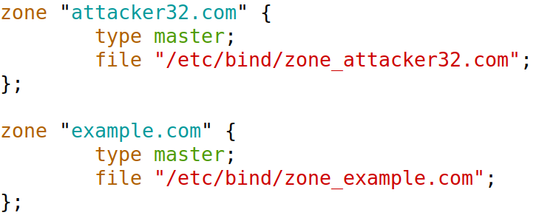
Set Up Two Zones on Attacker’s Nameserver
/etc/bind/named.conf

Slide 31
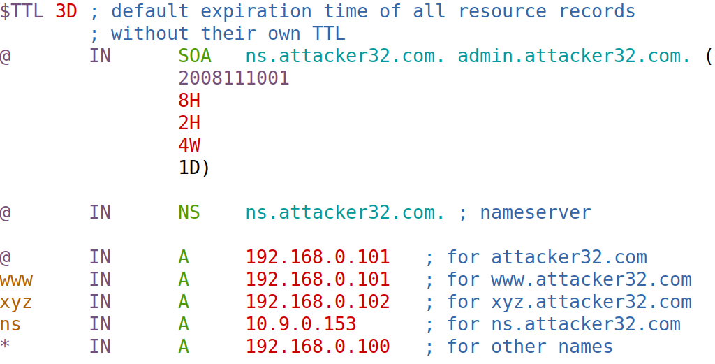
For Attacker32.com Domain
@: Represents the origin specified in named.conf (string after “zone”) [attacker32.com]

Slide 32
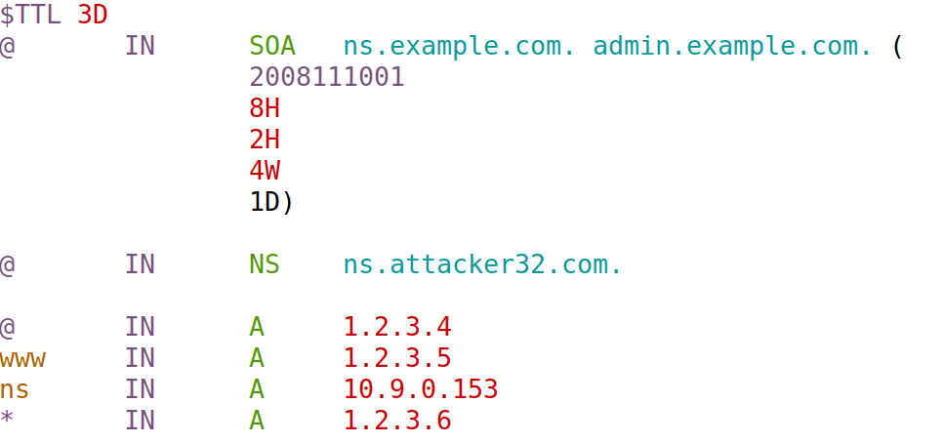
For Example.com Domain
If any change is made to the zone file, please remember to restart the nameserver or run the following command to ask the nameserver to reload the revised zone data
$ sudo rndc reload attacker32.com

Slide 33
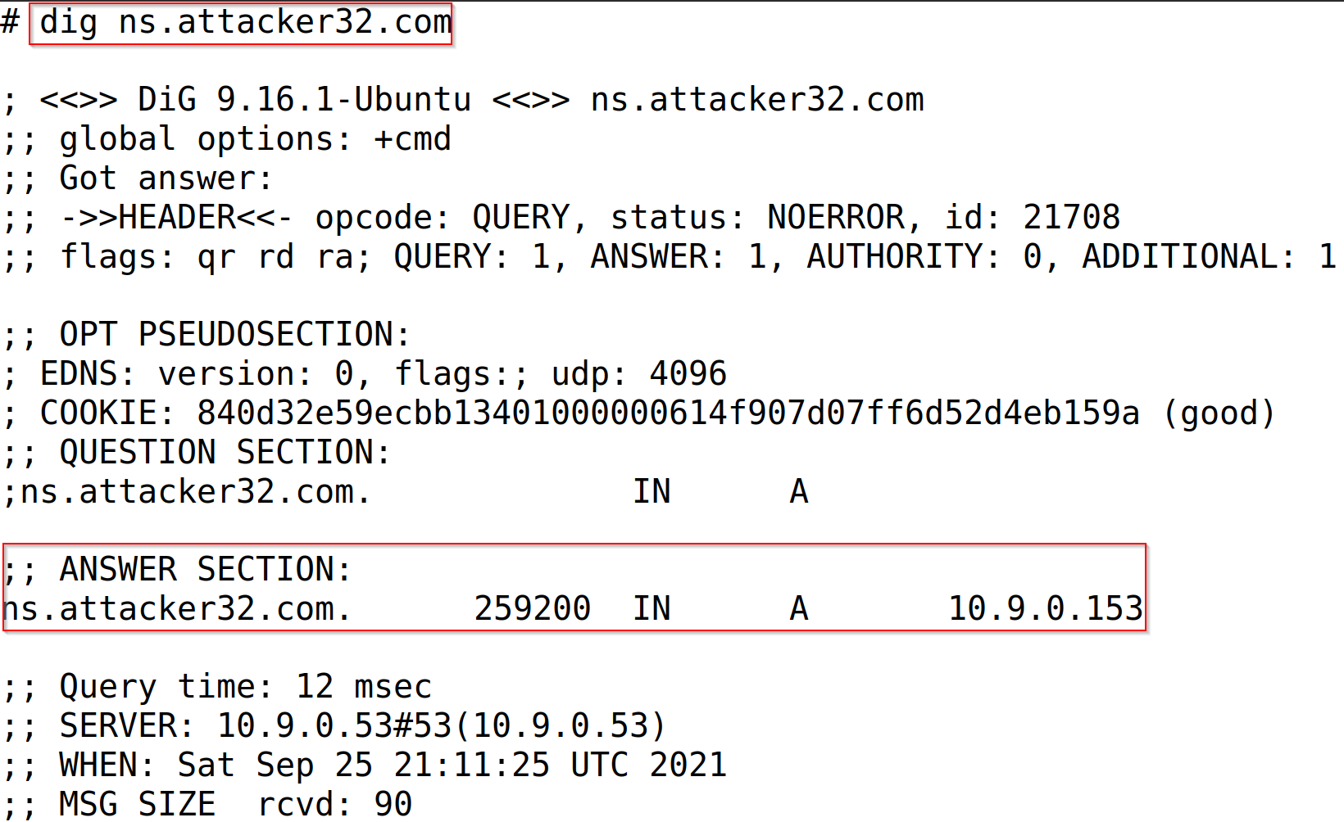
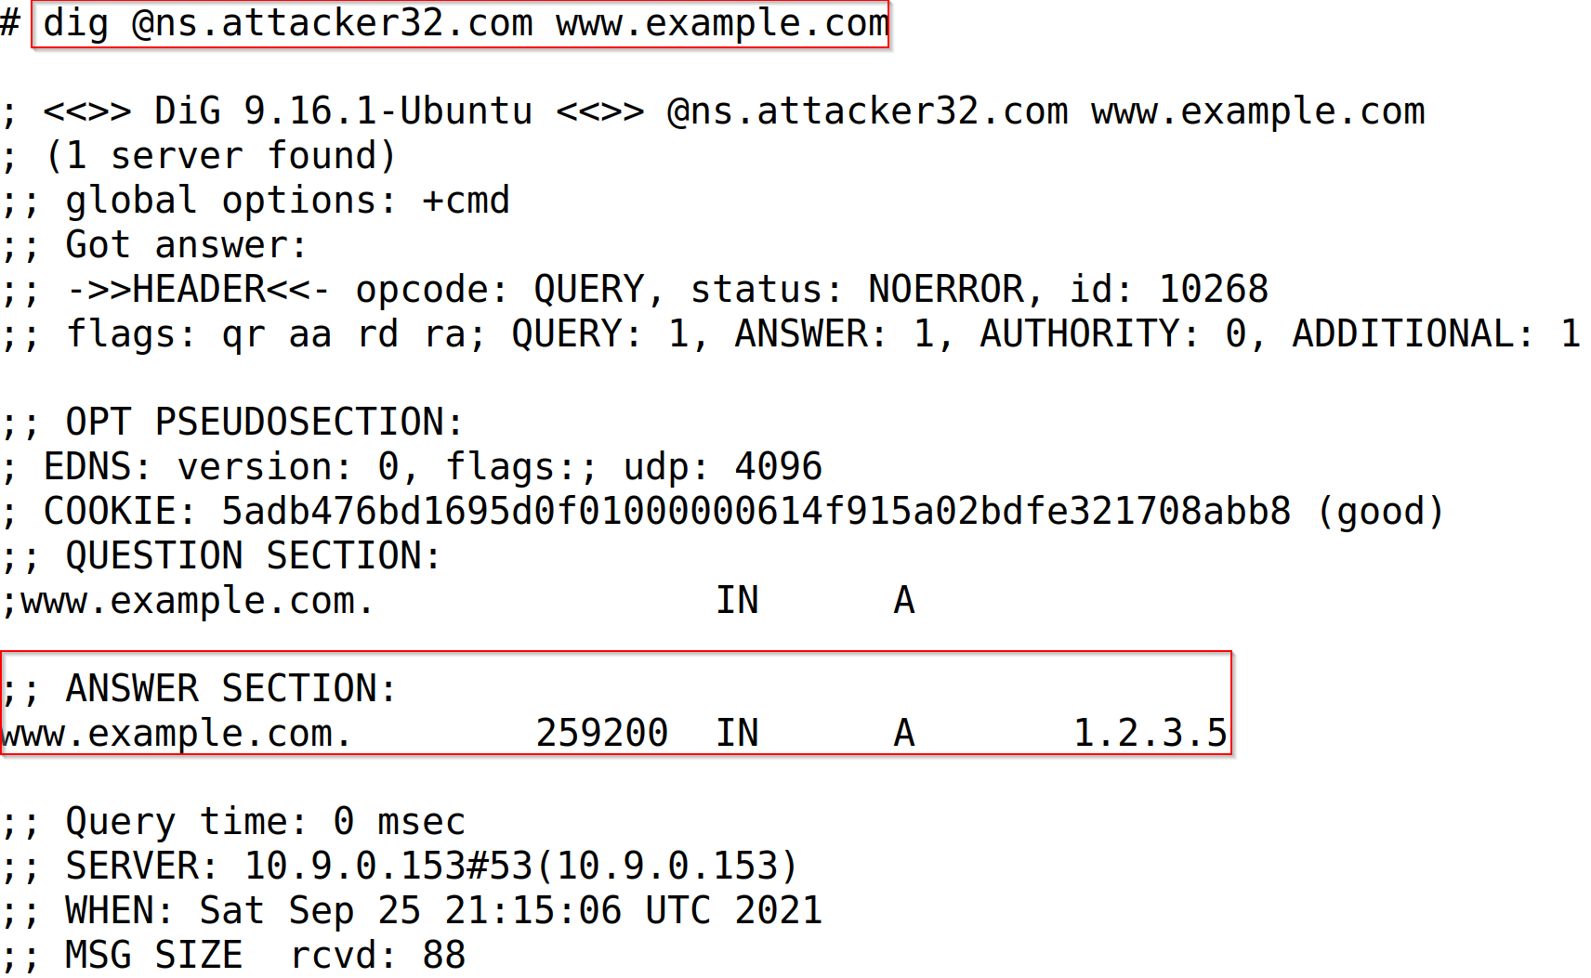
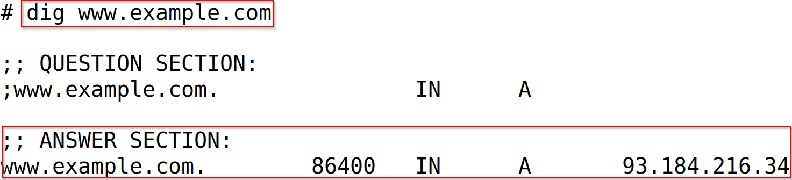
Test the Complete Setup on Victim Machine

Slide 34
DNS Attacks
Denial-of-Service Attacks (DoS): When the local DNS servers and the authoritative nameservers do not respond to the DNS queries, the machines cannot retrieve IP addresses which essentially cuts down the communication.
DNS Spoofing Attacks:
Primary goal: provide a fraudulent IP address to victims, tricking them to communicate with a machine that is different from their intention.
Example: If a user’s intention is to visit a bank’s web site to do online banking, but the IP address obtained through the DNS process is attacker’s machine, the user machine will communicate to the attacker’s web server.

Slide 35
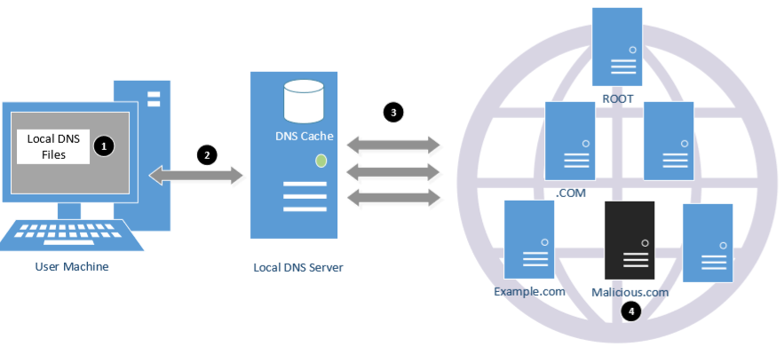
Overview of the Attack Surfaces

Slide 36
DNS Attacks on Compromised Machines
If attackers have gained the root privileges on a machine,
Modify /etc/resolv.conf: use malicious DNS server as the machine’s local DNS server and can control the entire DNS process.
Modify /etc/hosts: add new records to the file, providing the IP addresses for some selected domains. For example, attackers can modify IP address of www.bank32.com which can lead to attacker’s machine.

Slide 37
Local DNS Cache Poisoning Attack

Slide 38
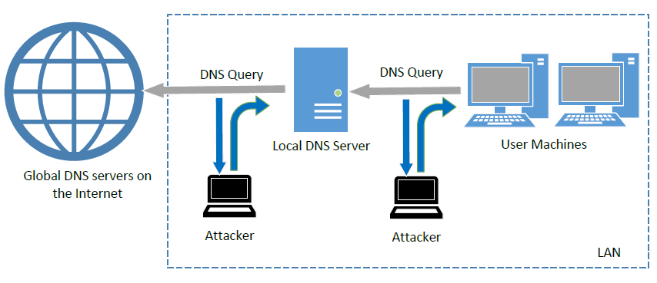
Spoofing DNS Replies (from LAN)
Notes:
Attacks on user machines : When the user machine sends out a DNS query to its local DNS server, attacker can immediately send a spoofed reply, using local DNS as its source IP address. Attackers can put any arbitrary IP address in the reply.
Attacks on local DNS server : Cache Poisoning attack : When the local DNS server sends out iterative queries to get an answer from the DNS servers on the Internet, attackers can send out spoofed replies to the local DNS server. They get accepted as long as they arrive before the actual replies. This is called DNS cache poisoning.

Slide 39
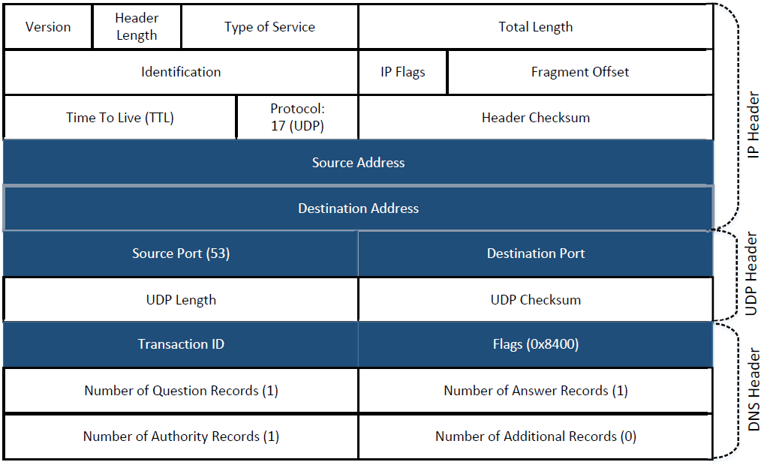
Spoofing Replies: IP and UDP headers

Slide 40
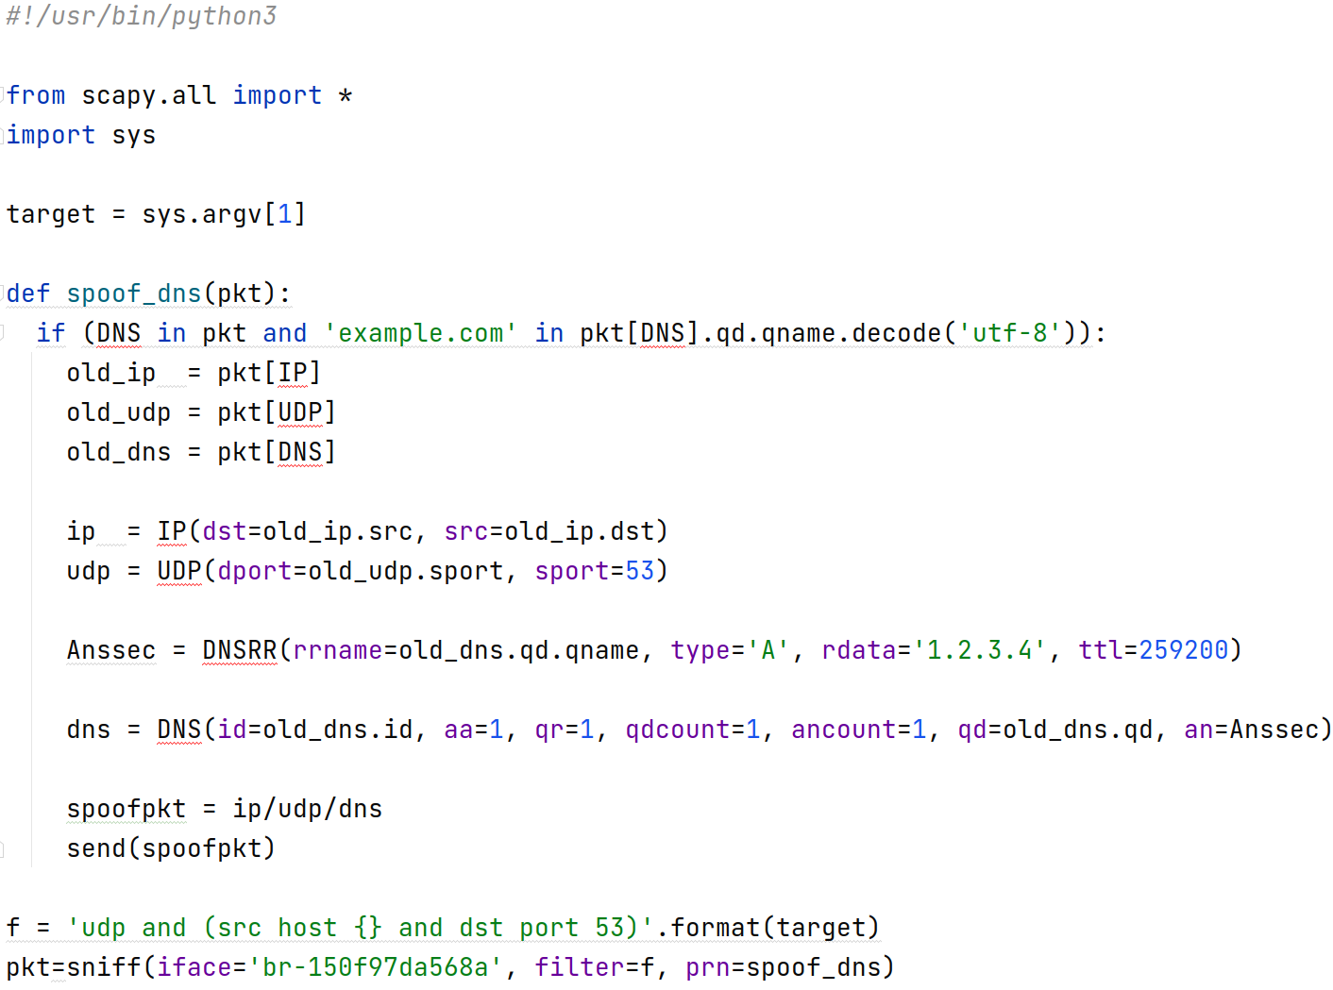
Local DNS Cache Poisoning Attack
Goal: Forge DNS replies after seeing a query from Local DNS Server

Slide 41
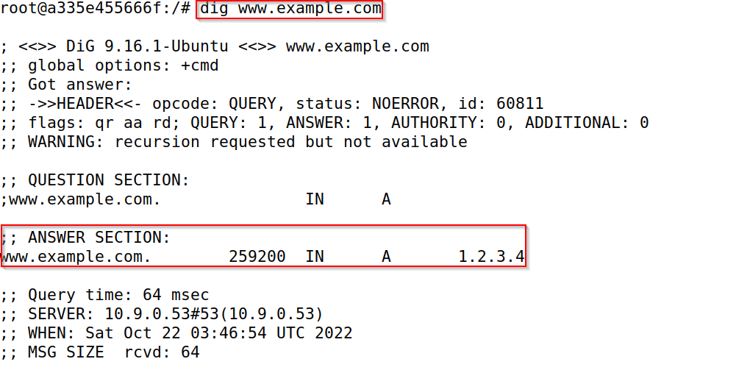
Local DNS Cache Poisoning Attack

Slide 42
How to Hijack the Entire Domain
The above attack only targets the Answer section in the reply which affects only the hostname
We can also forge the authority section (NS record) so that when the victim local DNS server tries to find any IP address in the target domain, it will send a request to the malicious name server specified in the fake NS record which affects all the hostnames in the target domain

Slide 43
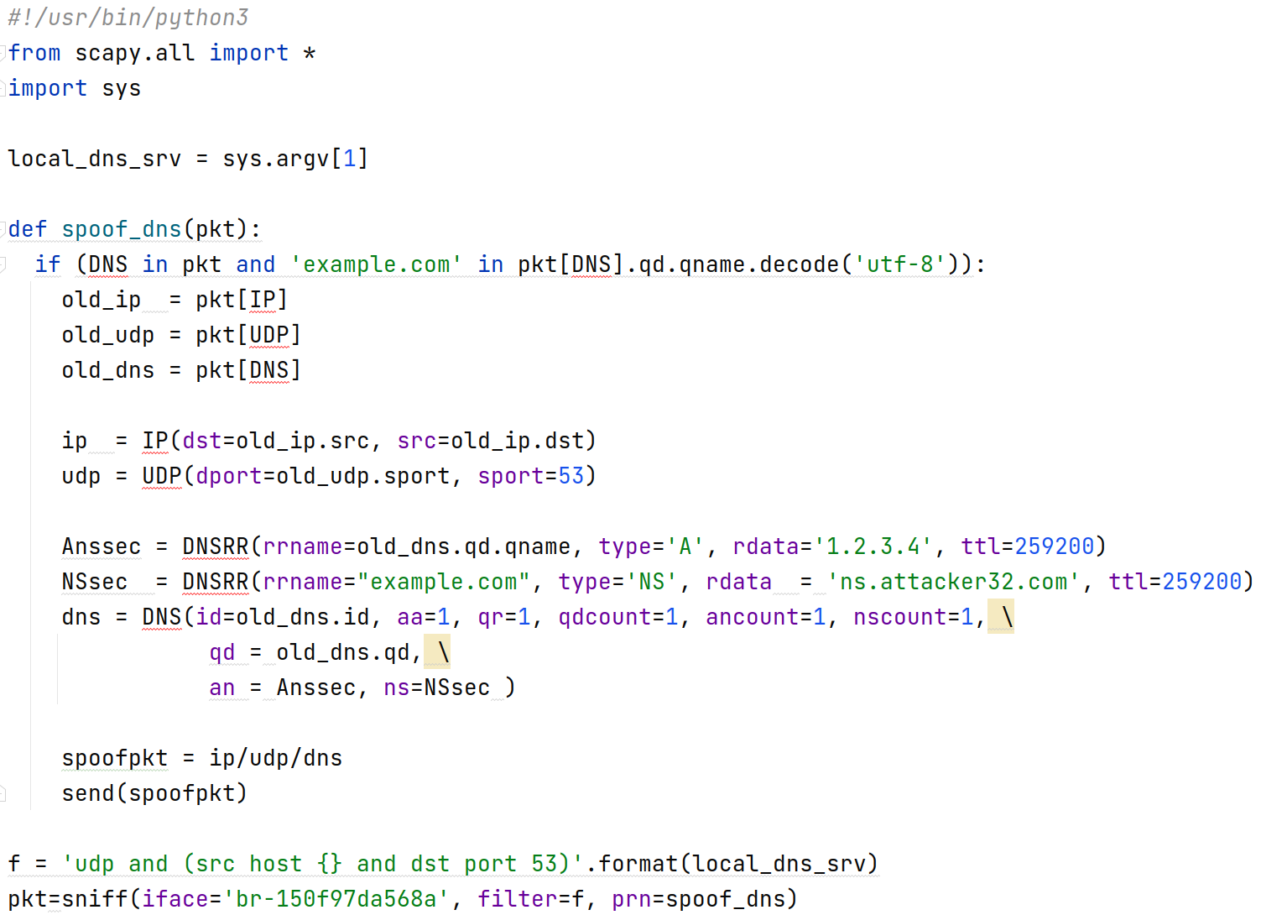
Targeting the Authority Section

Slide 44
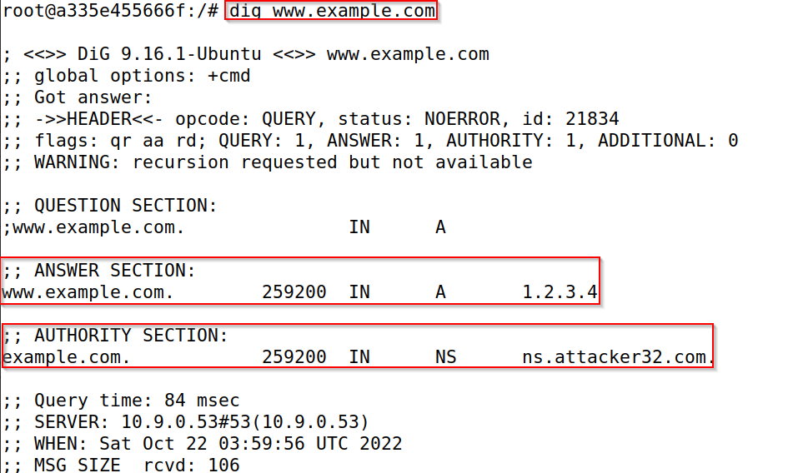
Attacking Result

Slide 45
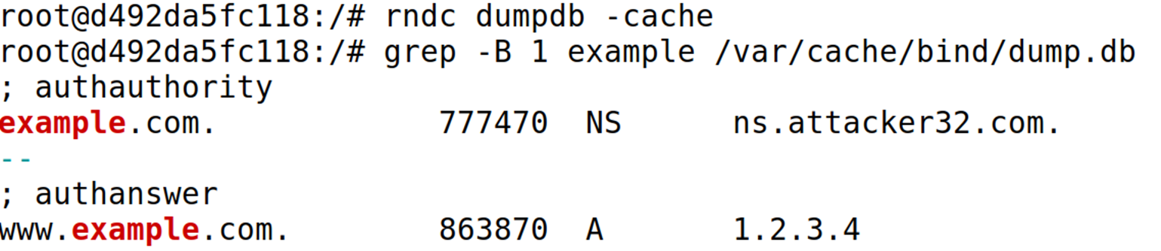
Inspect the Cache
Run $ sudo rndc dumpdb –cache to dump the local DNS cache
Run $ less /var/cache/bind/dump.db to check the contents of the DNS cache
Clean the cache using “$sudo rndc flush” before doing the attack.

Slide 46
Remote DNS Cache Poisoning Attack

Slide 47
Challenges
Challenges: For remote attackers who are not on the same network as the local DNS server, spoofing replies is much more difficult, because they need to guess two random numbers used by the query packet:
Source port number (16-bit random number)
Transaction ID (16-bit random number)
Cache effect: If one attempt fails, the actual reply will be cached by local DNS server; attacker need to wait for the cache to timeout for the next attempt.

Slide 48
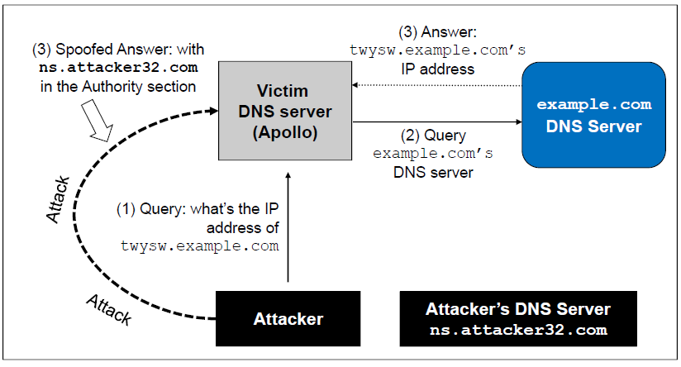
The Kaminsky Attack
How can we keep forging replies without worrying about the cache effect?
Kaminsky’s Idea:
Ask a different question every time, so caching the answer does not matter, and the local DNS server will send out a new query each time.
Provide forged answer in the Authority section
Notes:
Twysw.example.com is a random name
While Apollo waits for the reply, the attacker floods Apollo with a stream of spoofed DNS replies each with a different transaction ID and UDP destination port. The attacker also provides an NS record showing ns.attacker32.com as the nameserver. A different name will be used in the next attempt.
If the spoofed DNS response fails, the attacker will go back to the first step and repeat the steps but with a different hostname. This defeats cache effect.

Slide 49
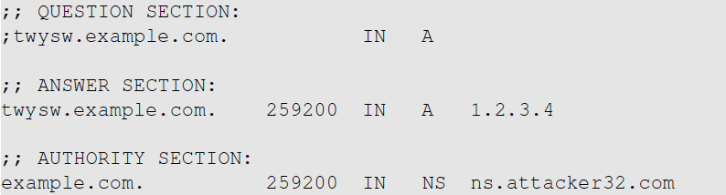
The Kaminsky Attack: A Sample Response
This random name will change for each attack attempt
This answer does not matter
This is what we want the local DNS server to cache
Tell the DNS server to use this one as the nameserver for the example.com domain

Slide 50
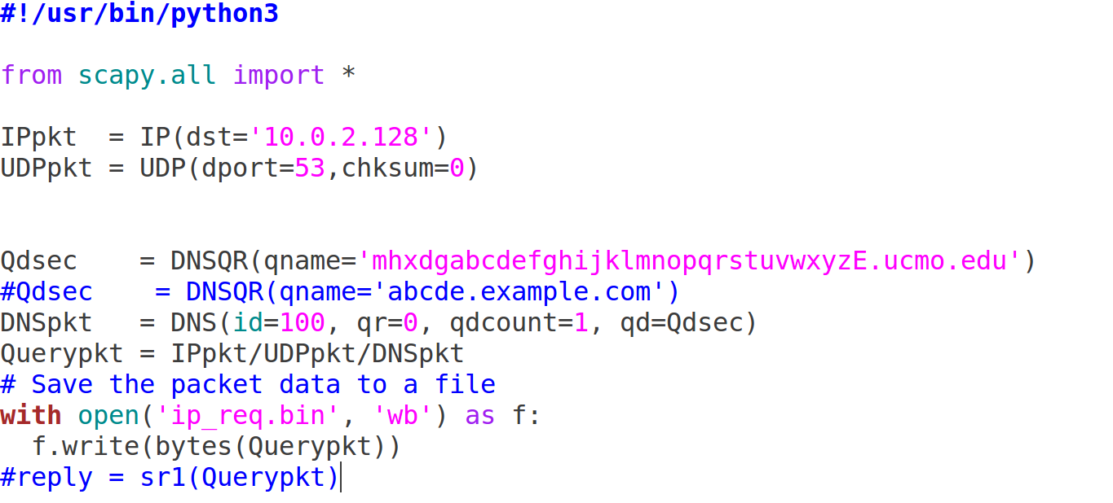
Sending DNS Request to the Local DNS Server

Slide 51
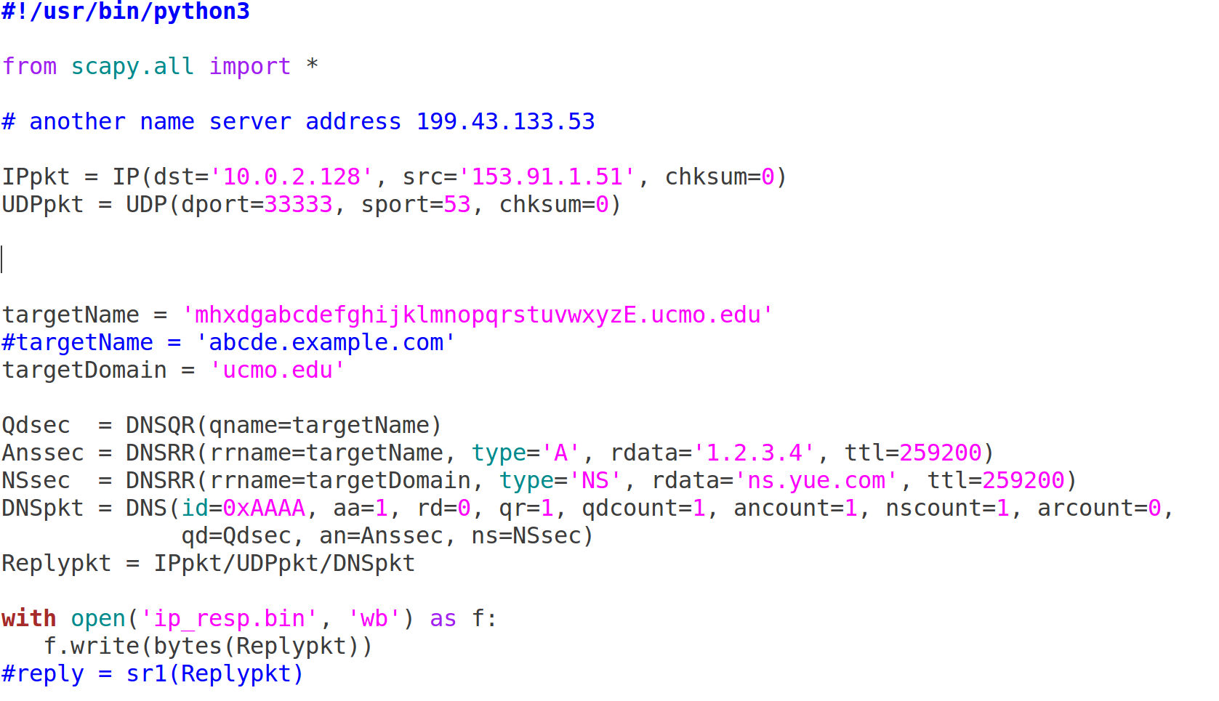
Creating a Spoofed DNS Response

Slide 52
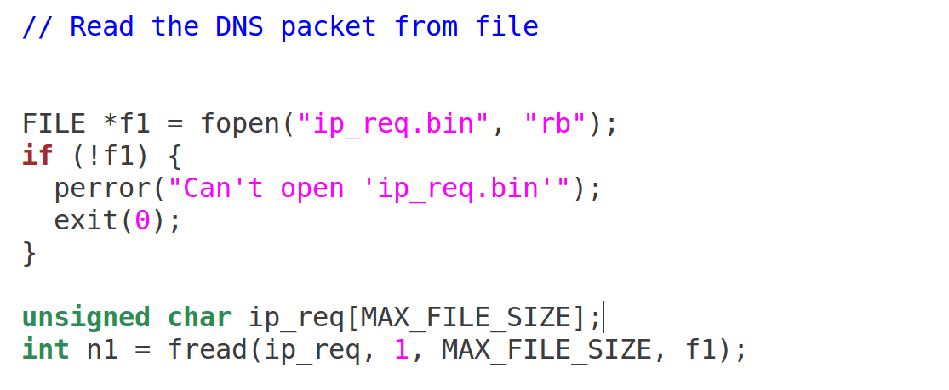
Loading Pre-generated DNS Packet into C Program

Slide 53
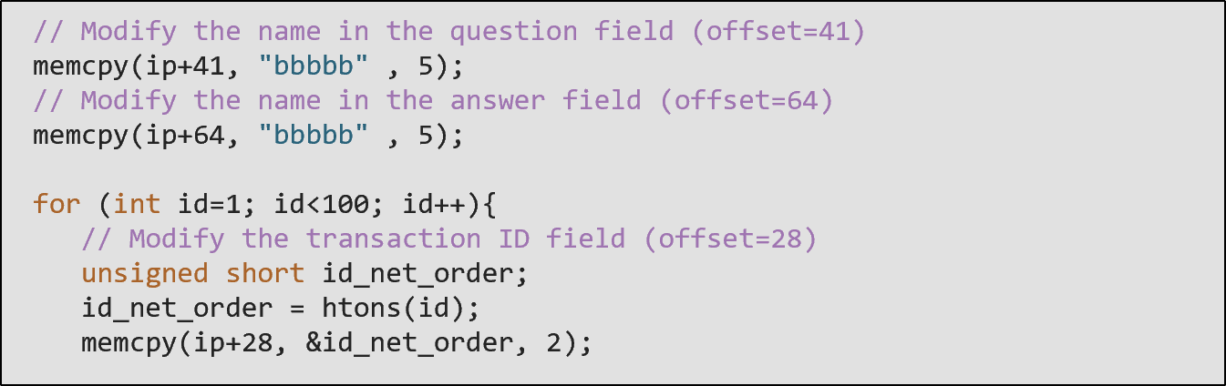
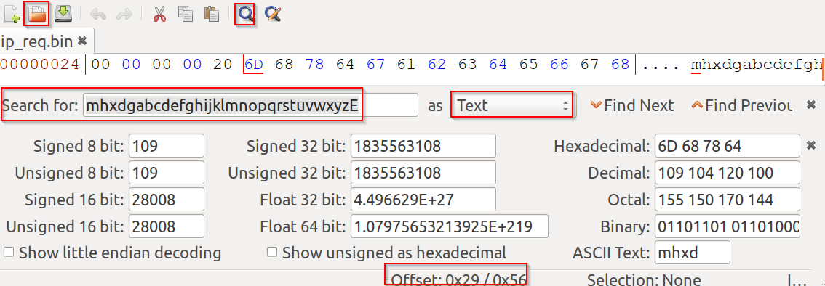
Modify the DNS Packet in C

Slide 54
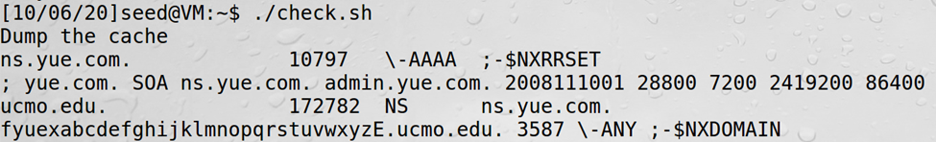

Verify the Attack Result

Slide 55
Attacks from Malicious DNS Server

Slide 56
Attacks from Malicious DNS Server
When a user visits a website, such as attacker32.com, a DNS query will eventually come to the authoritative nameserver of the attacker32.com domain. In addition to providing an IP address in the answer section of the response, DNS server can also provide information in the authority and additional sections. Attackers can use these sections to provide fraudulent information.
Notes:
Three scenarios
Lying about the authority section
Lying about the additional section
Lying about the answer section

Slide 57

Sample of a Valid DNS Response

Slide 58

Fake Data in the Authority Section
This one is allowed
This one is out of zone, and should be discarded

Slide 59


Query Result
Creating Fake records on the attacker DNS server
Query Result

Slide 60


Fake Data in the Additional Section
In DNS replies, there is section called Additional Section, which is used to provide additional information. In practice, it is mainly used to provide IP addresses for some hostnames, especially for those appearing in the Authority section
Additional information is provided
They will be discarded: out of zone. They will cause security problems if not discarded.
Notes:
When answering the query about www.attacker32.com, the authoritative nameserver tells the client IP addresses for some popular domain names.
If the fake information is accepted by the client (local DNS server), DNS cache will be poisoned with these fraudulent IP addresses.
As the information is out of zone, it will be discarded by the client.

Slide 61


Query Result
Creating Fake records on the attacker DNS server
Query Result

Slide 62

Reply Forgery Attacks from Malicious DNS Servers
This one is allowed
This one is not allowed (out of zone). The local DNS server will get the IP address of this hostname by itself.

Slide 63



Query Result
Creating Fake records on the attacker DNS server
Query Result

Slide 64

Result Verification

Slide 65
Question
If we hijacked one of the name servers for .com zone, will the following authority record be cached on the local DNS server?
facebook.com NS ns1.attacker32.com
Notes:
Yes since facebook.com is a subdomain within the .com zone

Slide 66
Reply Forgery in Reverse DNS Lookup
In the reverse lookup, a DNS query tries to find out the hostname for a given IP address.
Question: Can we use the hostname obtained from reverse DNS lookup as the basis for access control?
Example: Packets from ucmo.edu are allowed to access certain services.
To answer this question, we need to know how to do reverse lookup

Slide 67
Reverse DNS Lookup
Example :
Given an IP address, 128.230.171.184, the DNS resolver constructs a “fake name” 184.171.230.128.in-addr.arpa and then send queries through an iterative process.
We emulate the entire reverse lookup process using @ option in the dig command.

Slide 68


Reverse DNS Lookup
Step 1: Ask a root server. We get the nameservers for the in-addr.arpa zone.
Step 2: Ask a nameserver of the in-addr.arpa zone. We get nameservers for the 153.in-addr.arpa zone

Slide 69


Reverse DNS Lookup
Step 3: Ask a nameserver of the 153.in-appr.arpa zone. We get the nameservers for the 91.153.in-addr.arpa zone
Step 4: Ask a nameserver of the 91.153.in-appr.arpa zone. We get the final result

Slide 70



Reverse Lookup Zone File
/etc/bind/named.conf
/etc/bind/192.168.0.db

Slide 71
Review Our Question
Question: Can we use the hostname obtained from reverse DNS lookup as the basis for access control?
Answer:
If a packet comes from attacker, the reverse DNS lookup will go back to the attacker’s nameserver (to check on the attacker’s IP address)
Attackers can reply with whatever hostnames they want

Slide 72
Protection Against DNS Cache Poisoning Attacks
DNSSEC
DNSSEC is a set of extension to DNS, aiming to provide authentication and integrity checking on DNS data.
With DNSSEC, all answers from DNSSEC protected zones are digitally signed.
By checking the digital signatures, a DNS resolver is able to check if the information is authentic or not.
DNS cache poisoning will be defeated by this mechanism as any fake data will be detected because they will fail the signature checking.

Slide 73
DNS Rebinding Attack

Slide 74


DNS Rebinding Attack Lab Setup

Slide 75


Password Protected IoT Device
Web server

Slide 76

DNS Rebinding Attack
Firewall
Web page with JavaScript code
Same Origin Policy
Attacker
The target server
(vulnerable)
Attack goal: interact with the target server from outside

Slide 77
Same Origin Policy (SOP)
The same-origin policy (SOP) is a critical security mechanism that restricts how a document or script loaded from one origin can interact with a resource from another origin. It helps isolate potentially malicious documents, reducing possible attack vectors
Two URLs have the same origin if the protocol, port (if specified), and host are the same for both
Same origin policy applies only to scripts. It prevents scripts on one origin from accessing data from another origin
SOP generally allows a domain to issue requests to other domains, but not to access the responses
SOP is enforced by the browser

Slide 78
SOP Example
http://cs.ucmo.edu/faculty/yue.html
URL | Outcome | Reason
http://cs.ucmo.edu/student/james.html | Same origin | Only the path differs
http://cs.ucmo.edu:8080/faculty/yue.html | Not same origin | Port differs
https://cs.ucmo.edu/faculty/yue.html | Not same origin | Protocol differs
http://cybr.ucmo.edu/faculty/yue.html | Not same origin | Host differs
http://cs.ucmo.edu/staff/mic/kinde.html | Same origin | Only the path differs

Slide 79

DNS Rebinding Attack

Slide 80

DNS Rebinding: Initial Zone File (attacker32.com)

Slide 81

DNS Rebinding: Modification
Restart the nameserver
# service named restart

Slide 82


Set Up User Machine
Disable Firefox DNS cache
Set the local DNS server
$ sudo gedit /etc/resolvconf/resolv.conf.d/head
$ sudo resolvconf -u

Slide 83

User VM: Start the IoT Server
URL for the IoT device
Add the following to /etc/hosts
192.168.60.80 www.seediot32.com
Test the IoT server
www.seediot32.com

Slide 84


Interacting with the IoT Device
Get temperature
Set temperature

Slide 85



Same Origin Policy
On IoT Device

Slide 86

Bypass the Same Origin Policy
The main idea for defeating the same origin protection comes from the fact that the policy enforcement is based on the host name, not on the IP address
Use www.attacker32.com in the URL to comply with the SOP policy

Slide 87
Denial of Services Attacks on DNS

Slide 88
Denial of Service Attacks on Root Servers
Attacks on the Root and TLD Servers :
Root nameservers: If the attackers can bring down the servers of the root zone, they can bring down the entire Internet. However, attack root servers is difficult:
The root nameservers are highly distributed. There are 13 (A,B….M) root nameservers (server farm) consisting of a large number of redundant computers to provide reliable services.
As the nameservers for the TLDs are usually cached in the local DNS servers, the root servers need not be queried till the cache expires (48 hrs). Attacks on the root servers must last long to see a significant effect.

Slide 89
Denial of Service Attacks on TLD Servers
Nameservers for the TLDs are easier to attack. TLDs such as gov, com, net etc have quite resilient infrastructure against DOS attacks. But certain obscure TLDs like country-code TLDs do not have sufficient infrastructure. Due to this, the attackers can bring down the Internet of a targeted country.

Slide 90

Attacks on Nameservers of a Particular Domain
UltraDNS: DNS provider for many major e-commerce companies such as Amazon, Walmart, Expedia. In 2004, DOS against this provider was launched which suffered an outage for an hour.

Slide 91



Attacks on Nameservers of a Particular Domain
Dyn network : In 2016, multiple DDoS attacks were launched against a major DNS service provider for companies like CNN, BBC, HBO, PayPal etc. The attacks are believed to have been launched through botnet consisting of different IoT devices like IP cameras, baby monitors etc. It caused major Internet services unavailable .

Slide 92
Attacks on Nameservers of a Particular Domain
DNSPod : In 2009, several DNS servers of a Chinese domain service provider were hit by DDoS.
The attack was meant to target one particular company (Baofeng.com) which is widely popular video streaming site in China.
On the next day of attack, when DNS responses previously cached by the other servers timed out, Baofeng’s media player on users’ machines could not find the IP addresses of the servers because of the attack.
Due to the bug in the media player software, instead of waiting, they continuously sent out DNS queries at a faster rate. Due to massive number of DNS queries, they flooded and congested the network of China Telecom (ISP). It impacted 20 provinces and is described as the worst Internet incident in China.

Slide 93
Summary
How DNS works
Spoofing Attacks on DNS
Local DNS cache poisoning attacks
Remote DNS cache poisoning attacks
Reply forgery attacks
Defense against DNS spoofing attacks
DNSSEC
TLS/SSL (https)
Denial of Services on DNS

